Slide 1
Web scraping to pymysql

Slide 2
Web Scraping
Web scraping is a technique used to extract data from
websites. It involves sending requests to a web server to retrieve web pages and then parsing the HTML . Like text, links, images.
HOW WEB SCRAPING WORKS
TOOLS AND LIBRARIES

Slide 3
HOW WEB SCRAPING WORKS

Slide 4
TOOLS AND LIBRARIES
BeautifulSoup: Used for parsing HTML and XML documents. It provides Pythonic idioms for iterating, searching, and modifying the parse tree.
Scrapy: A powerful and versatile scraping framework for large-scale web scraping projects.
Selenium: A tool for automating web browsers, often used for scraping websites that rely heavily on JavaScript.

Slide 5
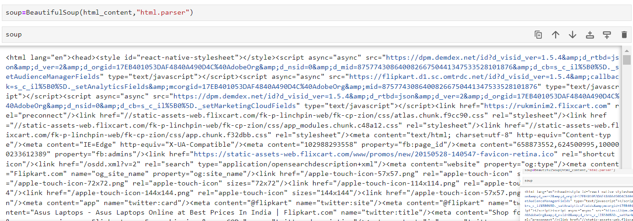
Parsing HTML with BeautifulSoup
BeautifulSoup is a popular Python library for parsing HTML documents. It provides methods to navigate the parse tree and extract data.

Slide 6
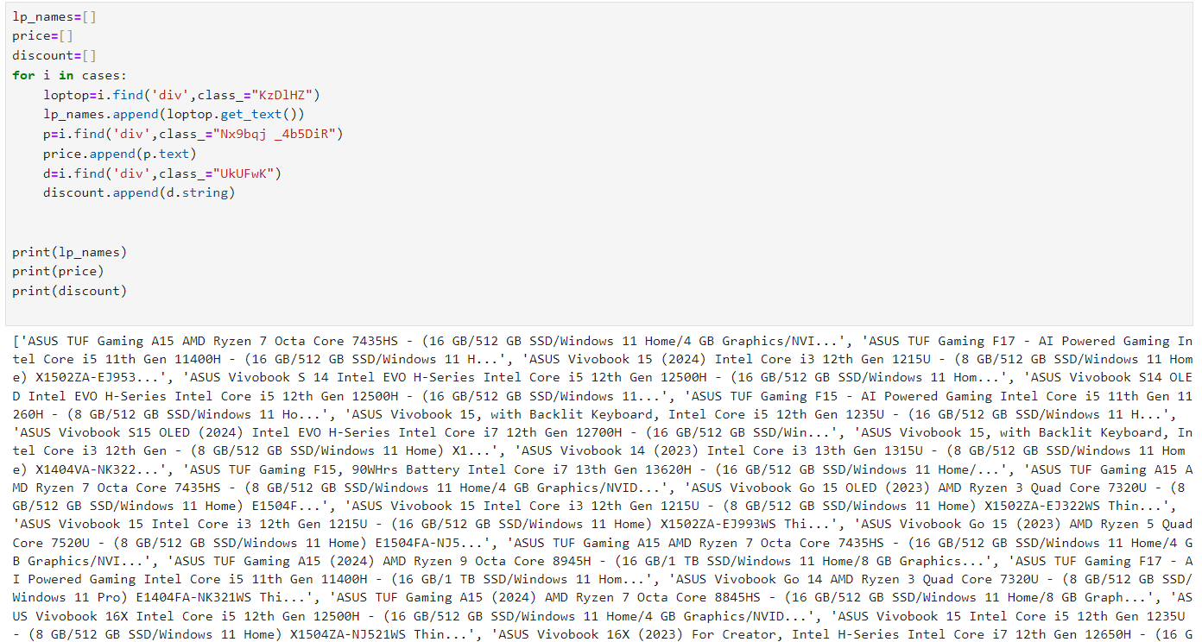
DATA CASES : When working with web scraping and data extraction. Like Handling Data Tables, forms, heading etc.

Slide 7
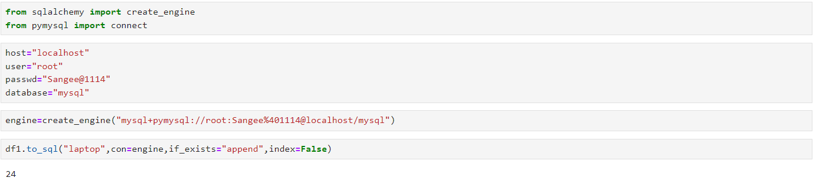
.
Storing scraped data into a MySQL database involves several steps, from connecting to the database to executing SQL queries for data insertion. Here’s a step-by-step guide to help you understand the process using Python with ‘pymysol’

Slide 8
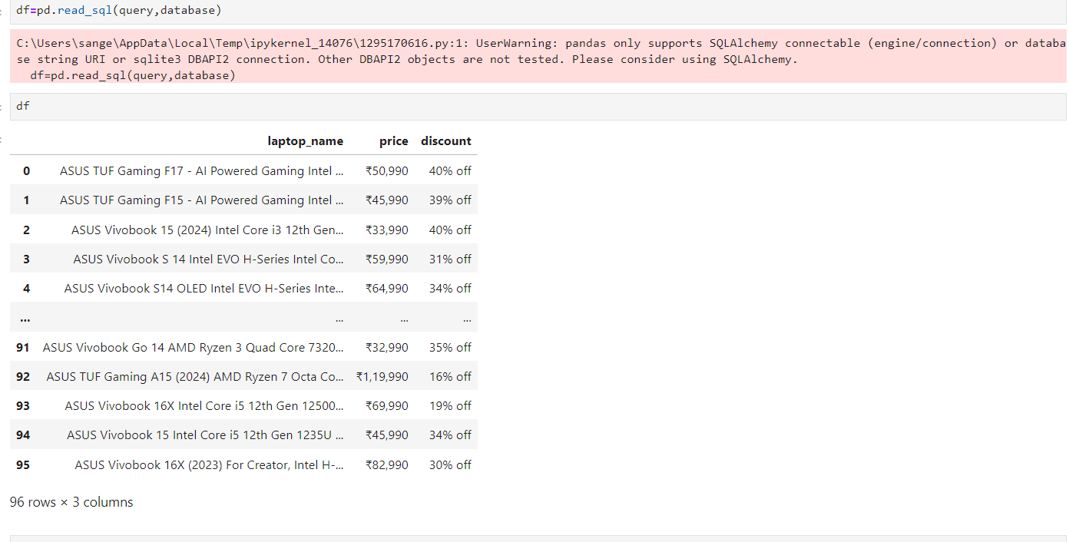
INSERT DATAFRAM INTO MYSQL
To insert a dataframe into mysql database using python, you can use the pandas library along with SQL alchemy or mysql-connector-python’.

Slide 9
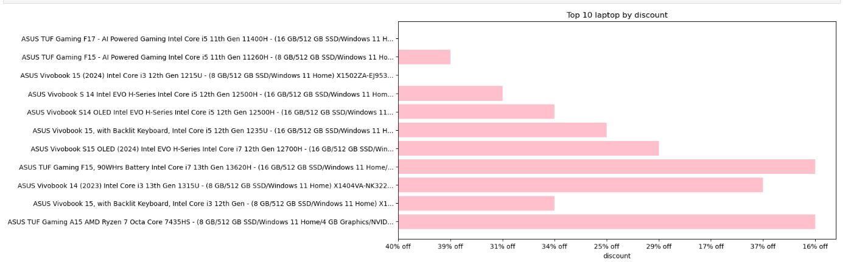
This field involves creating visual representations of data to make it easier to understand and analyze. Here are some common types and tools for data visualization

Slide 10
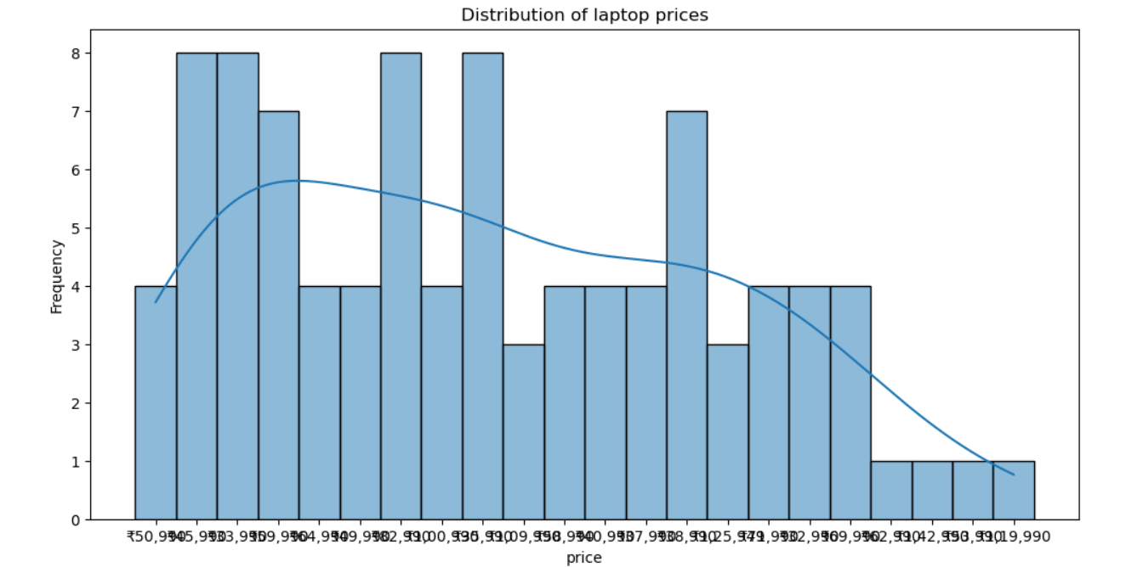
A count plot is a type of data visualization used to display the frequency distribution of categorical data. It shows the number of occurrences of each category in a dataset, making it easy to compare the sizes of different categories.

Slide 11


